Slide 1
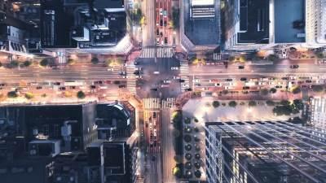
Crosswalk Detection

Slide 2
Outline
Introduction
Dataset
Model
Implementation
Results
Challenges
Conclusion

Slide 3
Introduction
Why is crosswalk detection so important?
The objective of this project…

Slide 4
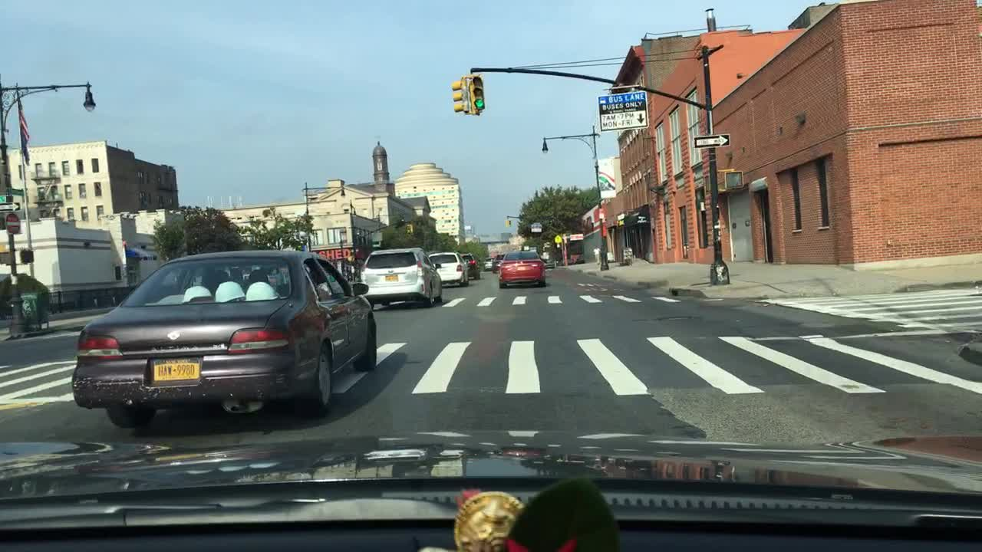


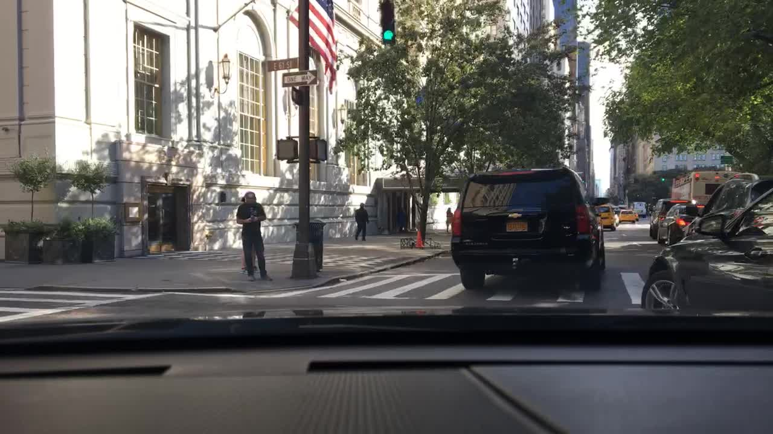
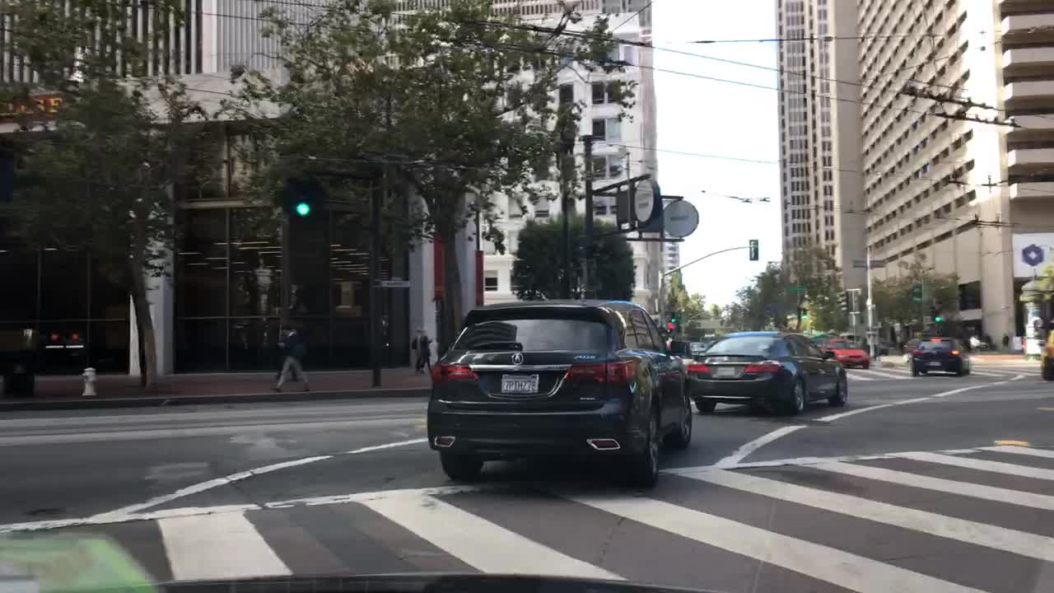
Dataset
Overview of BDD100K
Why is it chosen?

Slide 5
Dataset Analysis

Slide 6
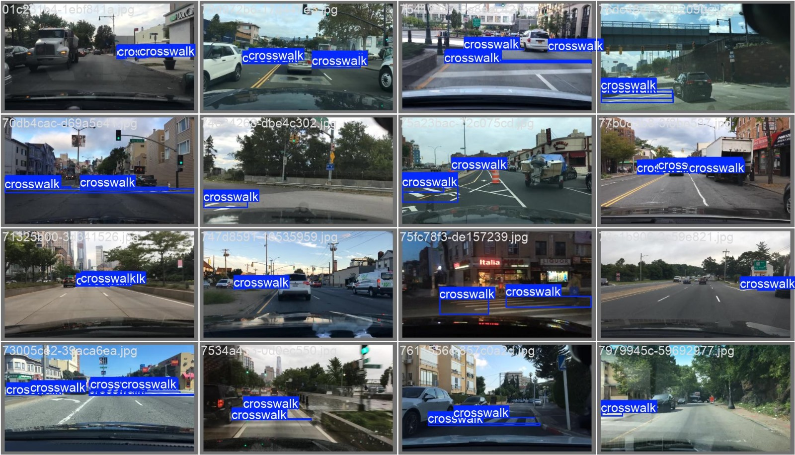
Model
The YOLOv8
Fine-tuning that we made.

Slide 7
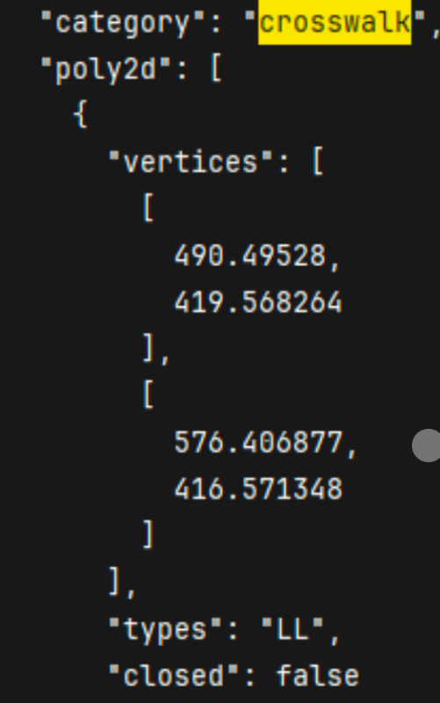
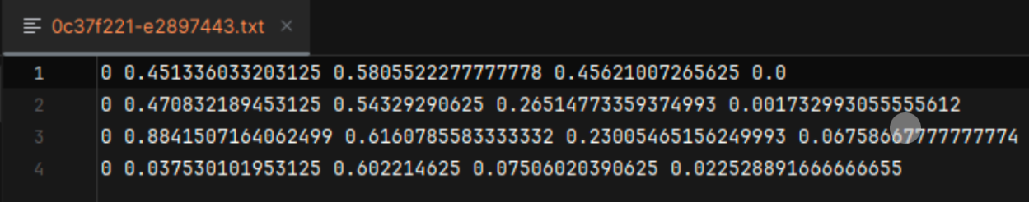
Implementation
Dataset preparation
Training and evaluation process

Slide 8
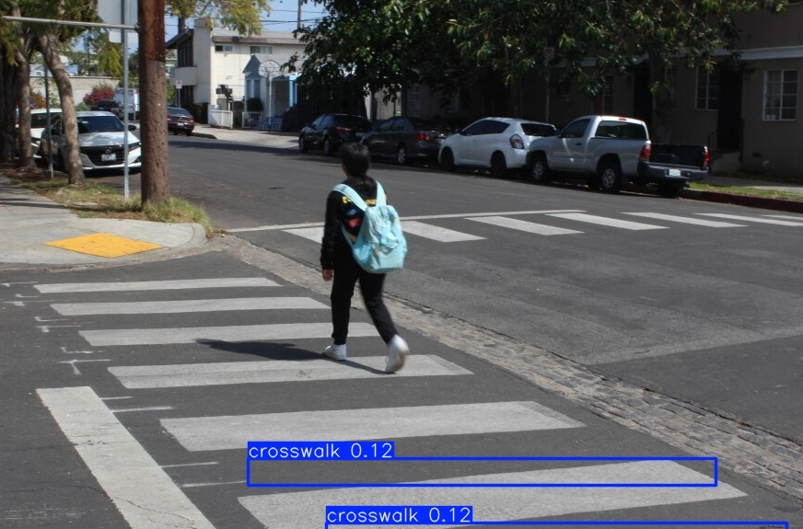
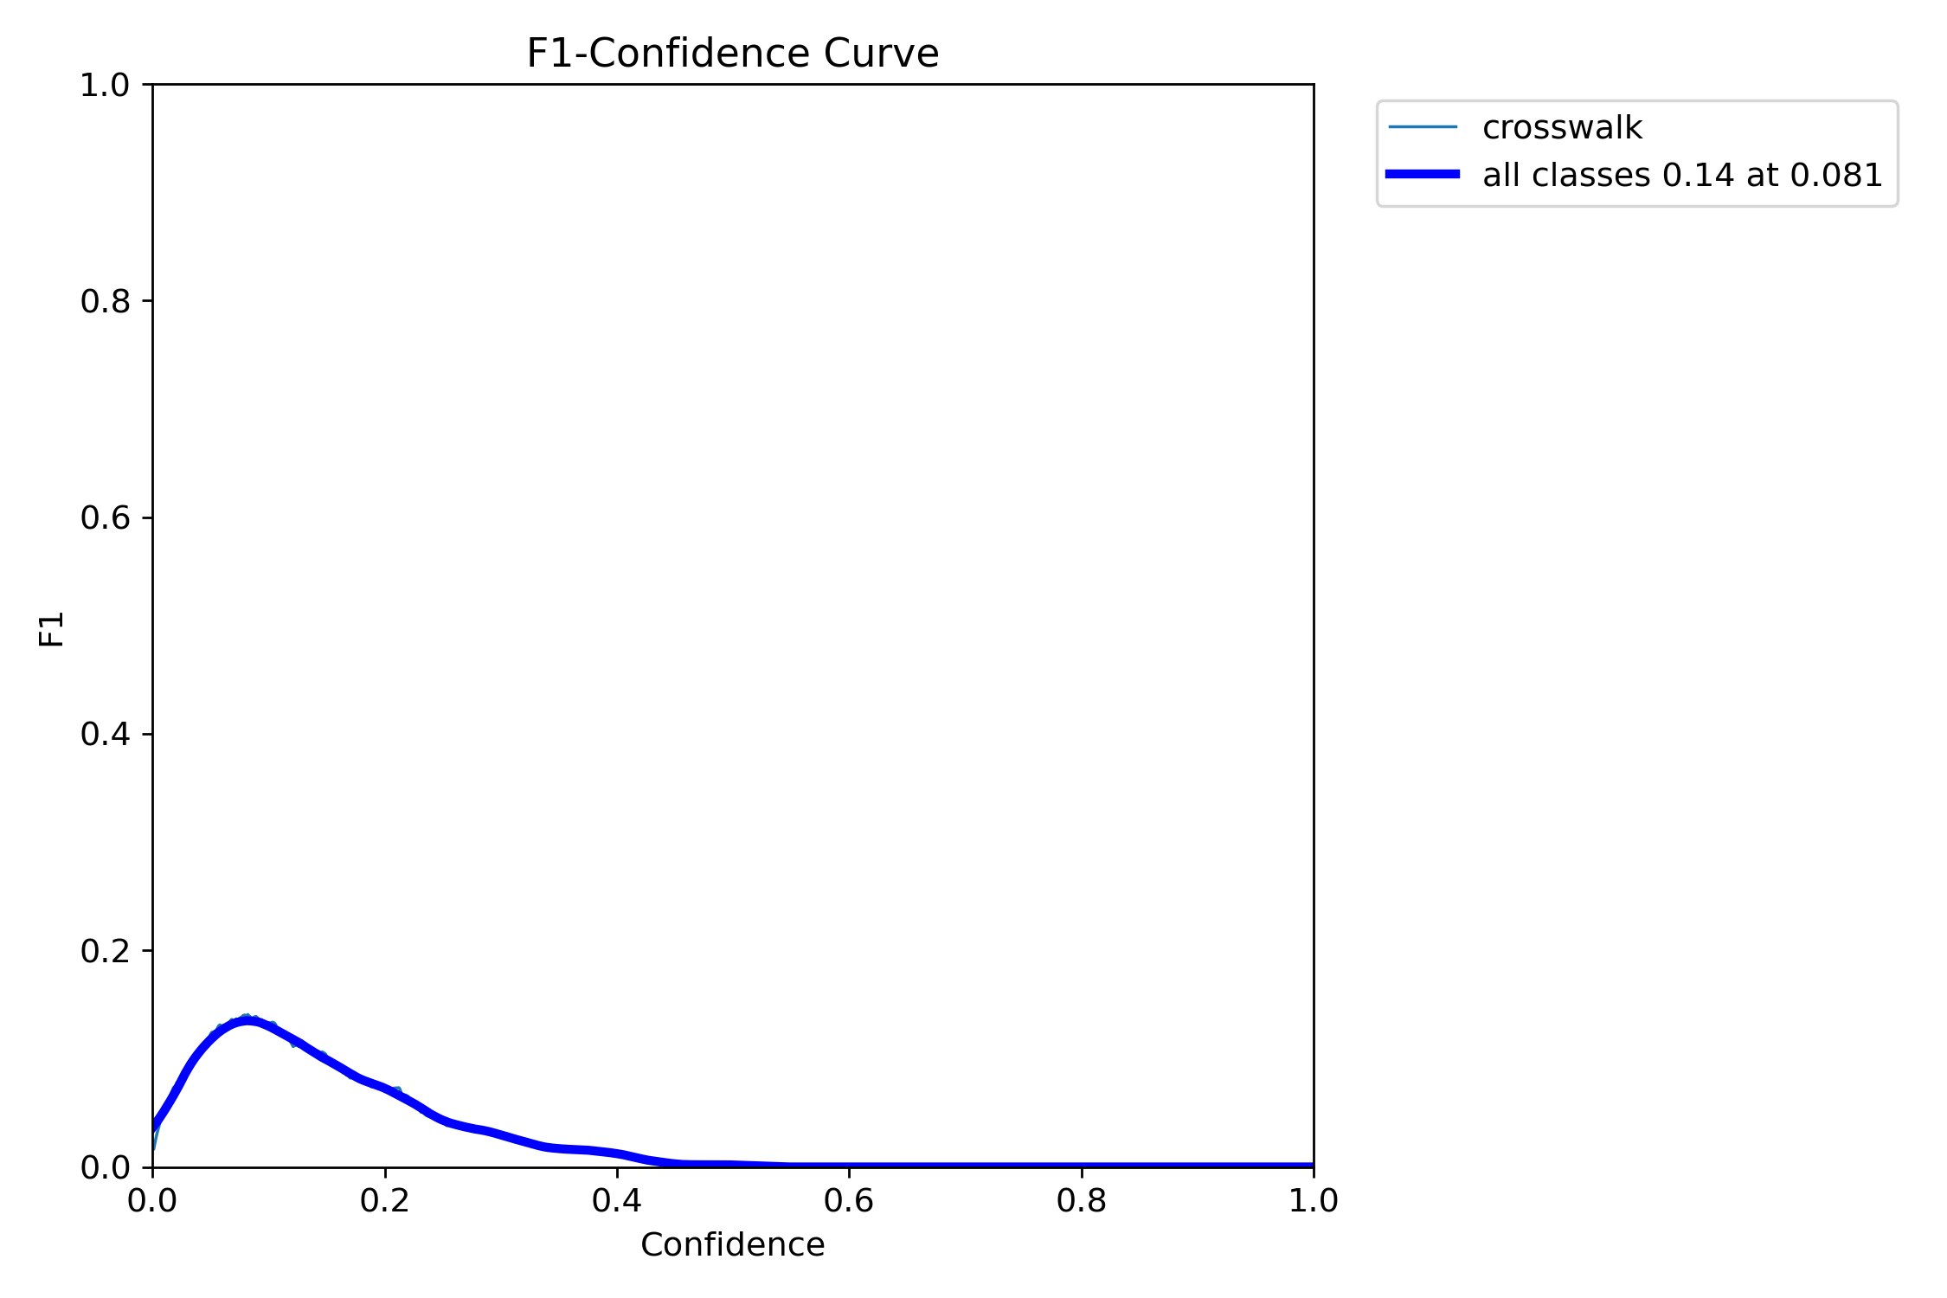
Results 1: BDD10K Training Set with 640p

Slide 9
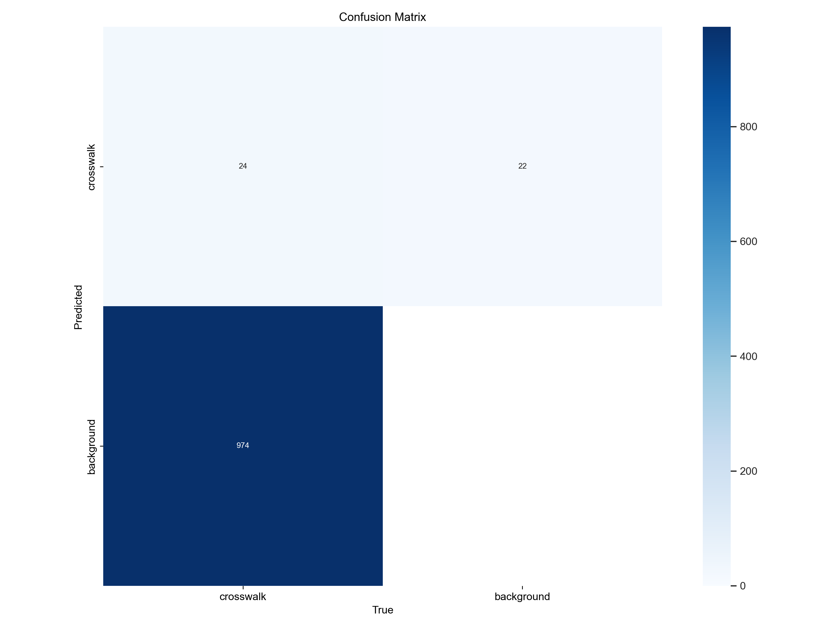
Result 1

Slide 10
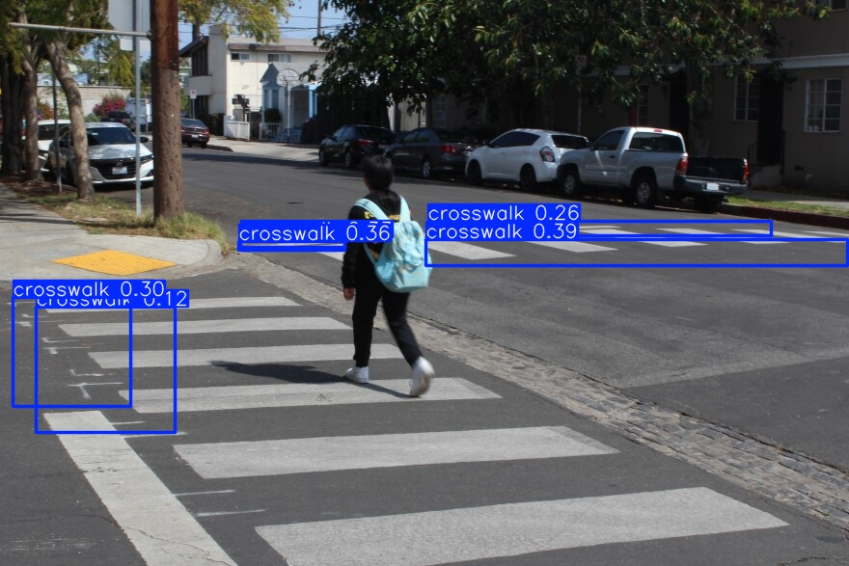
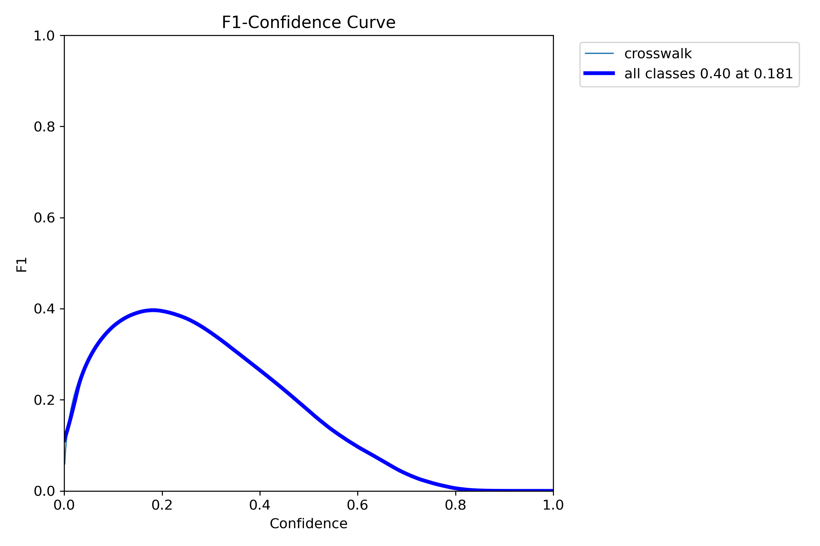
Results 2: BDD100K Training Set with 768p

Slide 11
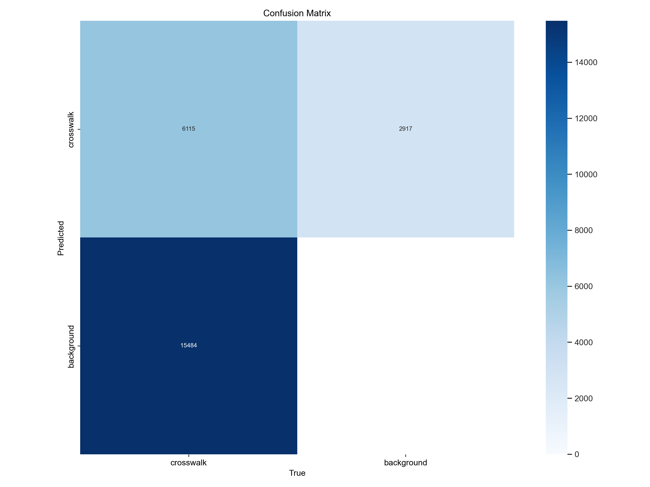
Result 2

Slide 12
Results 3: BDD100K Training Set with 1024p
Soon…

